Slide 1
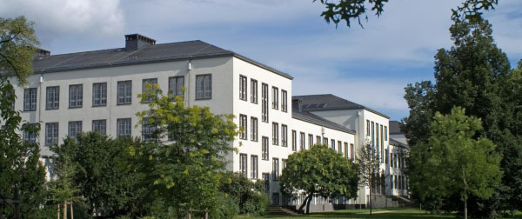
Efficiency Comparison of Various Approaches in E-Voting Protocols
Oksana Kulyk, Melanie Volkamer

Slide 2
Motivation of our research project
Many e-voting protocols exist
Election settings widely differ
Different security requirements
Different non-security requirements
Different ballots, voting rules, and number of voters
No „one-size-fits-all“ solution
→ Research question: How to choose the most appropriate one?
Notes:
M: nicht so weit aus einander, erste nicht animieren
Important to know other reasons, so that they could be adressed

Slide 3
Proposal: Decision support system
Module Database
Decision Support System
Specification of election setting
E-voting protocols
comparison result
Notes:
Talk about modules: ZKP, mix net, etc.

Slide 4
Focus of this paper
Many e-voting protocols exist, focus on mix net and homomorphic tallying based
Election settings widely differ
Different security requirements
Different non-security requirements, focus on efficiency
Different ballots, voting rules, and number of voters
No „one-size-fits-all“ solution
→ Research question: How to choose the most appropriate one?
Notes:
M: nicht so weit aus einander, erste nicht animieren
Important to know other reasons, so that they could be adressed

Slide 5
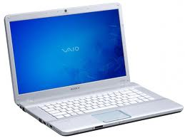
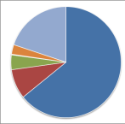
Protocol overview
Setup
Vote casting
Vote anonymisation
Tallying
Election key generation
Pre-computations
Encryption (Client)
Well-formedness proof (Client)
Verify proofs (Server)
Mixing (Trustees)
Zero-knowledge proof of shuffle validity
Decryption (Trustees)
Result decoding
Verify proofs
Computing a homomorphic sum
Notes:
Important to know other reasons, so that they could be adressed

Slide 6
Vote anonymisation
Mix-net
Terelius-Wikström 2010, Wikström 2014 (Implementation)
Homomorphic tallying focusing on different ballot types
Helios v.4 (Implementation)
Groth 2004
Joaqim 2014
Notes:
M: stand auf dem Paper immer nur einer?
M: erklären warum nur ein Mix net aber mehrereh homomorphic
mportant to know other reasons, so that they could be adressed

Slide 7
Tallying – Decryption
Used regardless of anonymisation approach
Performed by one or several trustees
Variants
Single key holder
Non-threshold key distribution
Threshold key distribution
Verifiable threshold distributed decryption
→Pedersen 1992
Notes:
M: stand auf dem Paper immer nur einer?
M: erklären warum nur ein Mix net aber mehrereh homomorphic
mportant to know other reasons, so that they could be adressed

Slide 8
Ballot types
 |  | Helios | Groth | Joaqim
Approval | kMin...kMax of L | Yes | No | Yes
 | 0...L of L | Yes | Yes | Yes
 | k...k of L | Yes | Yes | Yes
Divisive | (T,T) of L (use all T votes) | Yes | Yes | No
 | (t,T) of L (use all T votes) | Yes | No | No
 | (t,T) of L | Yes | No | Yes
Ranking | k of L (k < L) | No | No | Yes
 | L of L | No | Yes | Yes
Wikström (Mix)
Yes
Yes
Yes
Yes
Yes
Yes
Yes
Yes
Notes:
M: kann man die markieren für die jeweils das verfahren gemacht war
M: ist das die übliche Schreibweise oder müsste z.b min max tiefgestellt sein.
Ekläre nur 2-3 davon im Talk

Slide 9
Considering different phases
Setup
Vote casting
Vote anonymisation
Tallying
Notes:
How long does it take to anonymise the votes?
How long does it take to decrypt the votes?
If required: how long does it take to compute a discrete logarithm of decryption?

Slide 10
Relevant questions for each phase
Setup
Vote casting
Vote anonymisation
Tallying
How much data can be precomputed?
How long does it take for a voter to cast the vote?
How long does it take to verify the well-formness of all cast votes?
How long does it take to anonymise the votes?
How long does it take to decrypt the result?
How long does it take to decode the result?
Notes:
How long does it take to anonymise the votes?
How long does it take to decrypt the votes?
If required: how long does it take to compute a discrete logarithm of decryption?

Slide 11
Methodology
Count modular exponentiations for each approach
Assumptions
Optimized algorithms are in place
Fixed-base
Multi-exponentiations
Pre-computations are done by the server during setup
Notes:
Sagen zu jedem Punkt, was genau gemeint ist

Slide 12
Relevant parameters
Number of voters (expected and maximal)
Number of candidates
Number of trustees
Ballot type
Other ballot type specific parameters
Device performance (client and server)
Notes:
Explain why expected and maximal is relevant

Slide 13
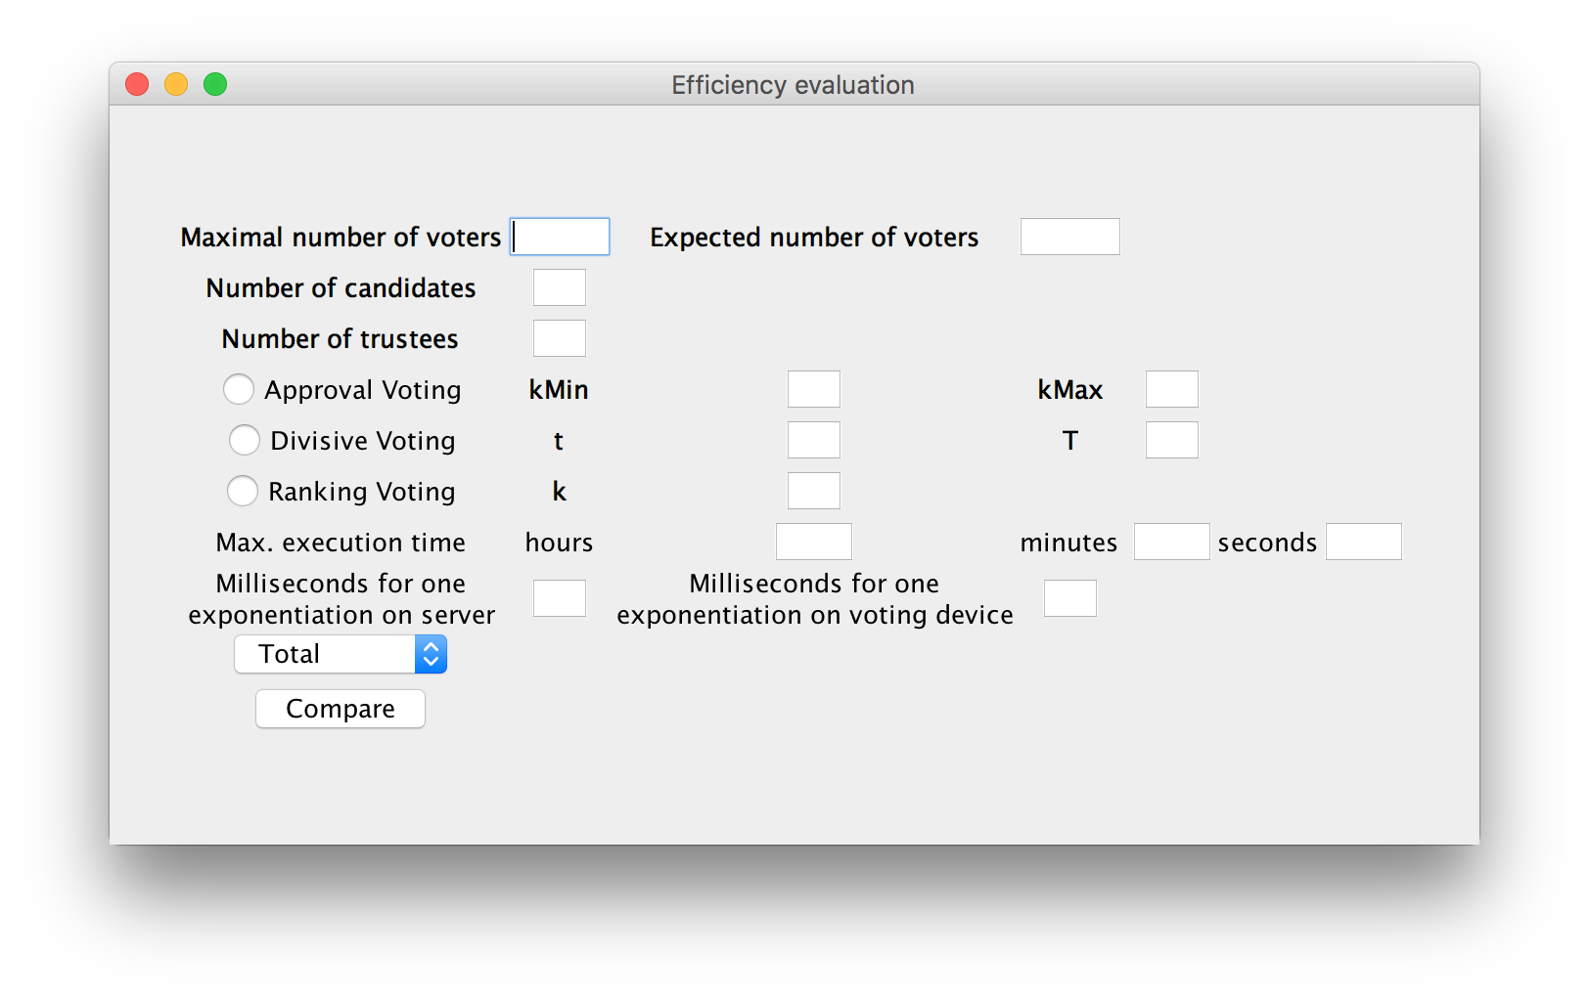
Tool implementation
Notes:
Important to know other reasons, so that they could be adressed

Slide 14
Case studies
Approval voting
Swiss referendums
Estonian elections
Norway elections (simplified version)
IACR elections
Boardroom voting
Divisive voting
→Local elections, state of Hesse
Borda ranking
→Victoria state elections
Notes:
Important to know other reasons, so that they could be adressed

Slide 15
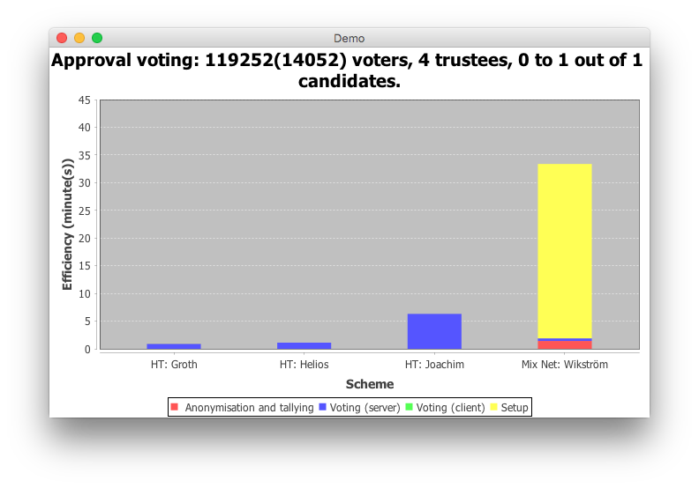
Swiss referendum
Notes:
Important to know other reasons, so that they could be adressed

Slide 16
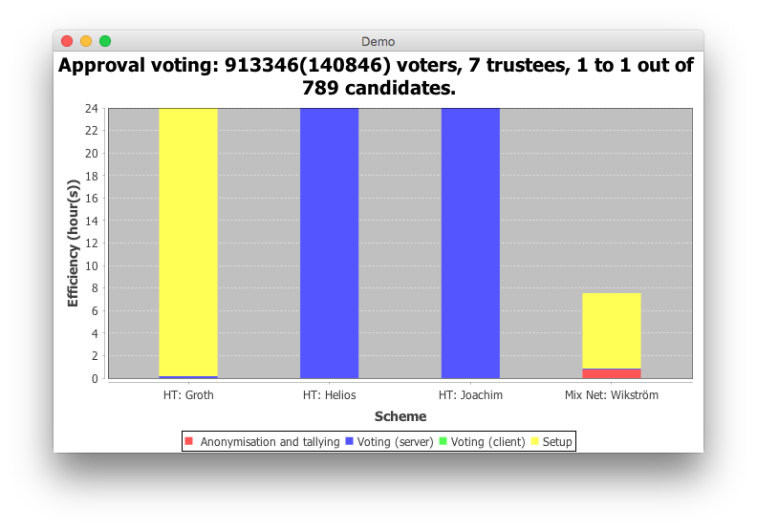
Estonia elections
Notes:
Important to know other reasons, so that they could be adressed

Slide 17
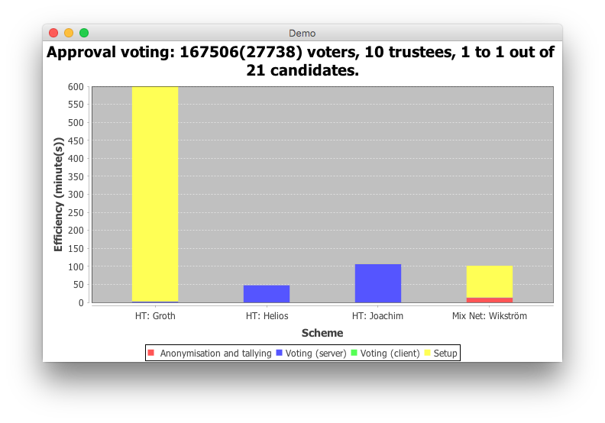
Norway elections
Notes:
Important to know other reasons, so that they could be adressed

Slide 18
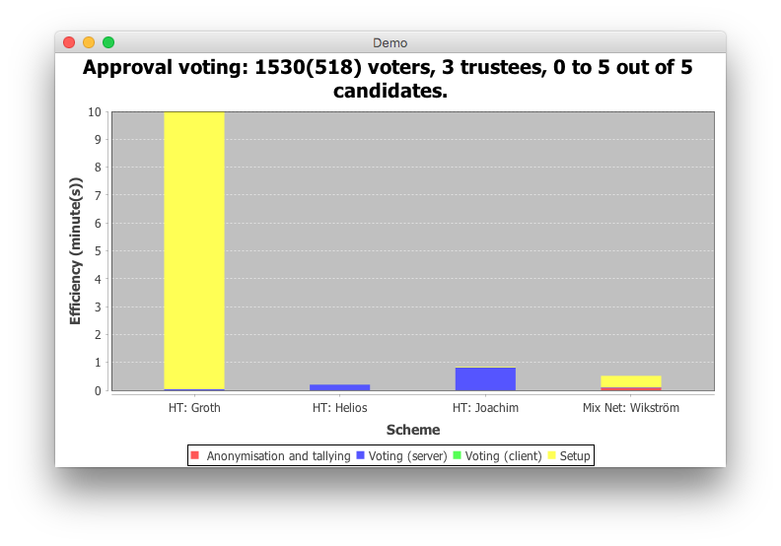
IACR elections
Notes:
Important to know other reasons, so that they could be adressed

Slide 19
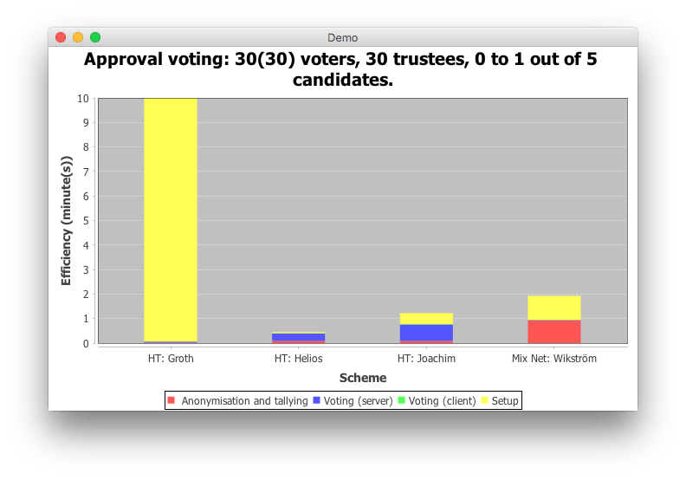
Boardroom voting
Notes:
Important to know other reasons, so that they could be adressed

Slide 20
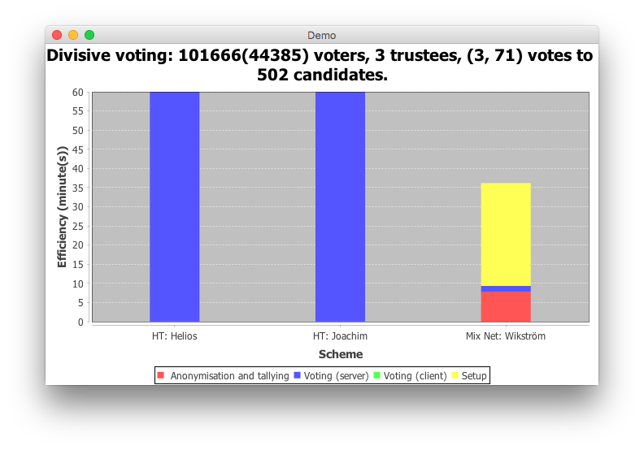
Local elections, State of Hesse
Notes:
Important to know other reasons, so that they could be adressed

Slide 21
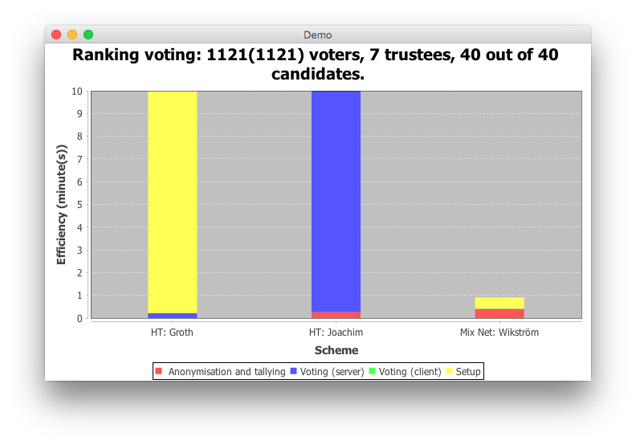
Victoria state election
Notes:
Important to know other reasons, so that they could be adressed

Slide 22
Conclusions
Mix net shuffling
Complex ballots
Large number of voters
Small number of trustees
Helios
Average ballot complexity
Average number of voters
Large variations in number of voters
Groth 2004
→ Very simple ballots
Notes:
Important to know other reasons, so that they could be adressed

Slide 23
Future work
More complex election rules
Implementation-specifics
Communication load
Number of available servers
Storage load
Trade-off with other criteria
Notes:
Important to know other reasons, so that they could be adressed

