Slide 1
Democracy²
E. Glen Weyl, Microsoft Research New England and University of Chicago
Keynote at Voting ’16 as part of FC16 on February 26, 2016

Slide 2
Plan for talk
Basic results
  Intuitions
  Formal result overview for various environments
Where we hope to apply this
  Long-term vision
  Short-term commercialization
Security issues
  Results on robustness to collusion and fraud
  Unique challenges for preventing

Slide 3
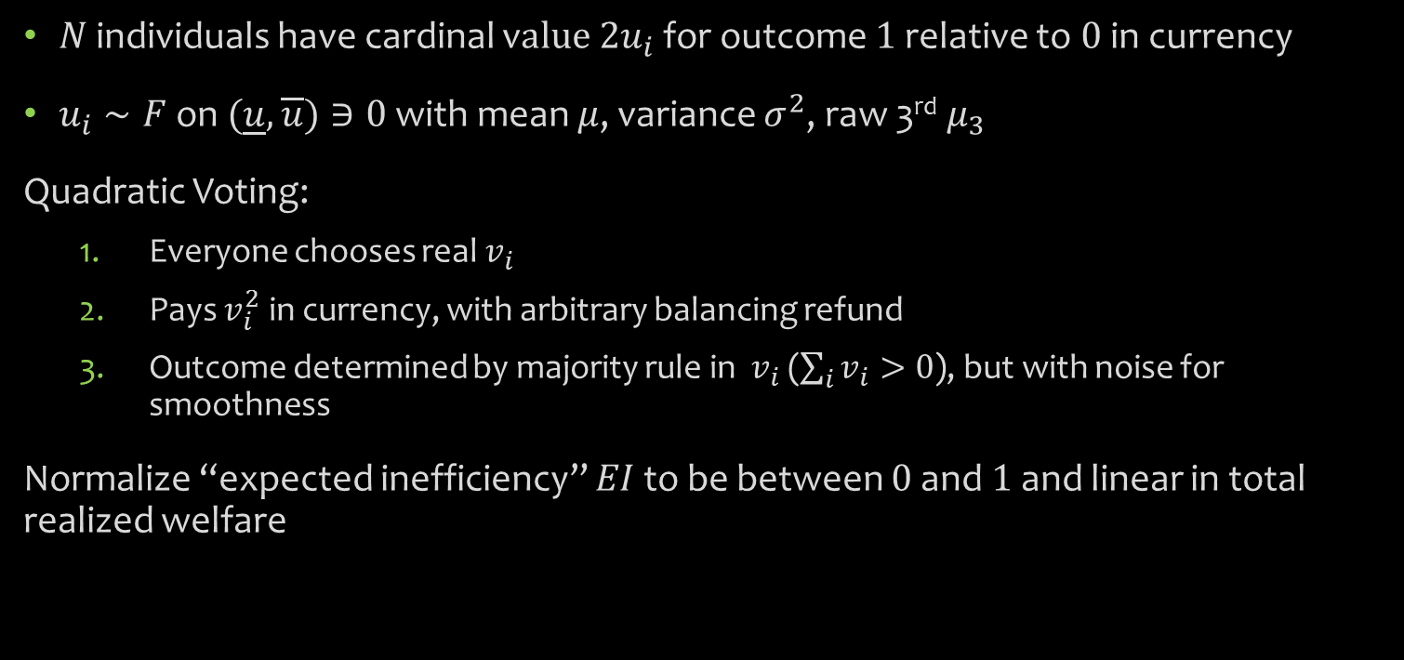
Model
$N$ individuals have cardinal v$alue {2u}_{i}$ for outcome $1$ relative to $0$ in currency
$u_{i}∼F$ on $(\underline{u},\overline{u})∋0$ with mean $μ$, variance $σ^{2}$, raw 3rd $μ_{3}$
Quadratic Voting:
  Everyone chooses real $v_{i}$
  Pays $v_{i}^{2}$ in currency, with arbitrary balancing refund
  Outcome determined by majority rule in $v_{i}$ ($\sum_{i}{v_{i}>0}$), but with noise for smoothness
Normalize “expected inefficiency” $EI$ to be between $0$ and $1$ and linear in total realized welfare

Slide 4
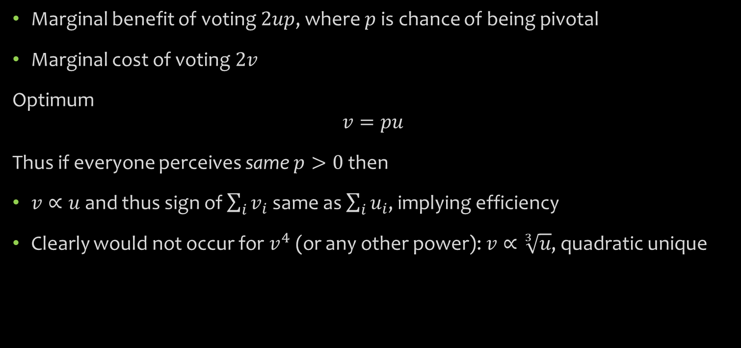
Heuristic argument
Marginal benefit of voting $2up$, where $p$ is chance of being pivotal
Marginal cost of voting $2v$
Optimum
$$v=pu$$
Thus if everyone perceives same $p>0$ then
$v∝u$ and thus sign of $\sum_{i}{v_{i}}$ same as $\sum_{i}{u_{i}}$, implying efficiency
Clearly would not occur for $v^{4}$ (or any other power): $v∝\sqrt[3]{u}$, quadratic unique

Slide 5
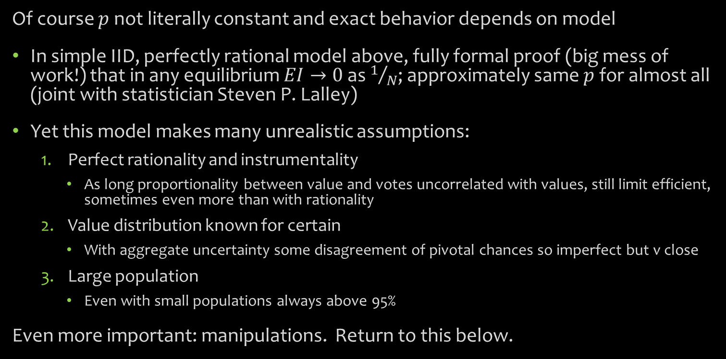
Formal results and alternatives
Of course $p$ not literally constant and exact behavior depends on model
In simple IID, perfectly rational model above, fully formal proof (big mess of work!) that in any equilibrium $EI→0$ as $1/N$; approximately same $p$ for almost all (joint with statistician Steven P. Lalley)
Yet this model makes many unrealistic assumptions:
  Perfect rationality and instrumentality
    As long proportionality between value and votes uncorrelated with values, still limit efficient, sometimes even more than with rationality
  Value distribution known for certain
    With aggregate uncertainty some disagreement of pivotal chances so imperfect but v close
  Large population
    Even with small populations always above 95%
Even more important: manipulations. Return to this below.

Slide 6
Range of applications
Obvious application broad-scale democracy but also
Voting on land assembly/eminent domain (w Jerry Green and Scott Duke Kominers)
Participatory budgeting
Corporate governance and bankruptcy (with law professor Eric Posner)
Social aggregation online (likes, reddit, credit for academics)
Massive multiplayer online video games
International organizations
Funding public goods (innovation, political campaigns, etc.) with matching

Slide 7
Ladder strategy
Long-term applications complicated, politically difficult: start w feasible/commercial
Short-term commercial: Collective Decision Engines
Medium-term: large scale private and small scale public
Long-term: large scale public
Use familiarity, commercial success to open minds, validate, improve

Slide 8
Collective Decision Engines
Focusing initially on market research/polling; friends and family stage
Founders: Eric Posner (Chicago law), Kevin Slavin (MIT media lab) and me
Advisers: Ellen Konar (former head of MR at Google), Eric Maskin (Nobel in Econ)…
Based in NYC, ~2 full time employees
weDesign software

Slide 9
Preliminary empirical results
QV appears to turn multimodal or otherwise weird Likert distributions of preferences into bell-shaped, normalish distributions.
QV does a much better job predicting behavior, as gauged by willingness to sign up for emails about issues.
QV yields interesting new insights about which aspects of preferences moderate, and which do not, when placed under budget constraint.

Slide 10
Implementations
Binary, one-shot referendum (only with money)
Multicandidate one-shot race
Prioritization
Many simultaneous binary issues (as in software)
Resource allocation
Repeated elections with persistent, storable currency

Slide 11
Collusive and fraudulent environments
All formal analysis of collusion in first case, with basic assumptions
Consider collusion (vote buying) and fraud (pretending to multiple identities)
Consider average and worst case collusive groups, and defrauders
Different informational environments (collusive group has or not perfect internal monitor, is or is not monitored by private citizens, the state)
Basic intuition: can overcome convexity, internalize benefit to others
But limits with small numbers as still gets convex quickly…and if public expects it reacts, can make self-defeating

Slide 12
Results on collusion and fraud
Bad cases:
Worst case (group of most extreme) colluders without any public monitoring
Very large number of colluders in any case (when government cannot catch)
Very large scale fraud
Good cases:
Average colluders in any case
Any case where public knows may exist (even if don’t know specific case)
Any case there are constant number of colluders in large population

Slide 13
Security challenges
Hard to have secret ballot; how to conceal payments? (with money)
How to prevent people giving others money to use on voting? (with money)
Avoiding some people having better sense of chance of tie than others (all systems)
Better or worse with persistent artificial currency?
Verifying that cardinal not just ordinal votes untampered…harder or easier?

Slide 14
Future research
I am working on academic, commercial and public sides
  Chief Research Officer for CDE
  Writing book Democracy² for popular audience
  Academic papers on robustness, small populations, eminent domain application, corporate bankruptcy application and general equilibrium version
Also trying to encourage work by others
  Conference at Chicago in April with scholars for many disciplines: classics, history of economic thought, law, etc.
  Sunoo Park and Ron Rivest will present something
  But many other challenges and we need as much help as we can get!

