Slide 1
The Importance of Being Earnest [in Security Warnings]
Serge Egelman (UC Berkeley)
Stuart Schechter (Microsoft Research)

Slide 2
Prologue
You’ve Been Warned: An Empirical Study on The Effectiveness of Web Browser Phishing Warnings
CHI ‘08, with L. Cranor and J. Hong
Controlled experiment to evaluate phishing warnings through the lens of the C-HIP model

Slide 3
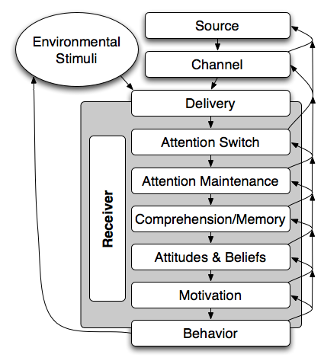
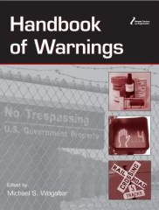
Communication-Human Information Processing (C-HIP) Model
Do users know what it means?
Do users understand what it wants them to do?
Do users notice the indicator?
Do users believe the indicator?
Are they motivated to take the recommended actions?
Will they perform those actions?
How do the indicators interact with other stimuli?
Wogalter, M. 2006. Communication-Human Information Processing (C-HIP) Model. In Wogalter, M., ed., Handbook of Warnings. Lawrence Erlbaum Associates, 51-61.
Notes:
To pinpoint problems with physical world warnings, the C-HIP model was created, which I have used to identify problems with web browser security warnings.

Slide 4
Lessons Learned
Interrupt the primary task
Force the user to notice and respond
Prevent habituation
Serious warnings should not be confused with less serious ones
Provide clear choices
If the warning is understood, recommendations are still needed
Fail safely
The recommended action should always be obvious or a default
Draw trust away from the website
Warnings should not have to compete with a suspicious website
Serious warnings should either distort or not show the website

Slide 5
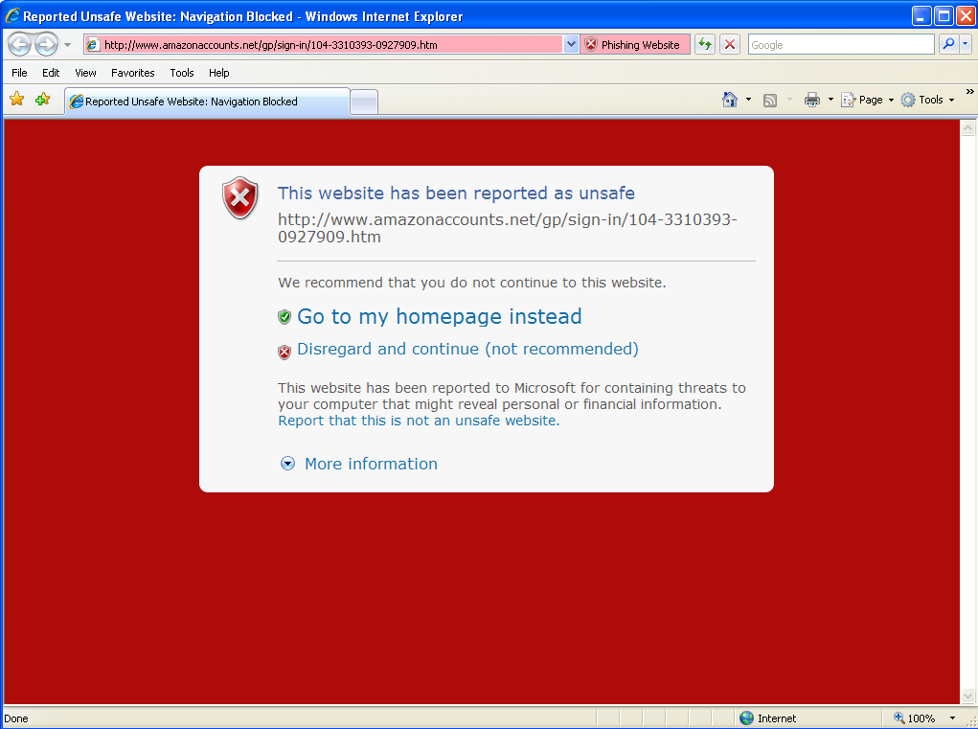
Impact: Changes were afoot!

Slide 6
Validation

Slide 7
…so we tested it
Does option text matter?
Does red background matter?
Laboratory study
Eye tracking
45 participants
3 conditions

Slide 8
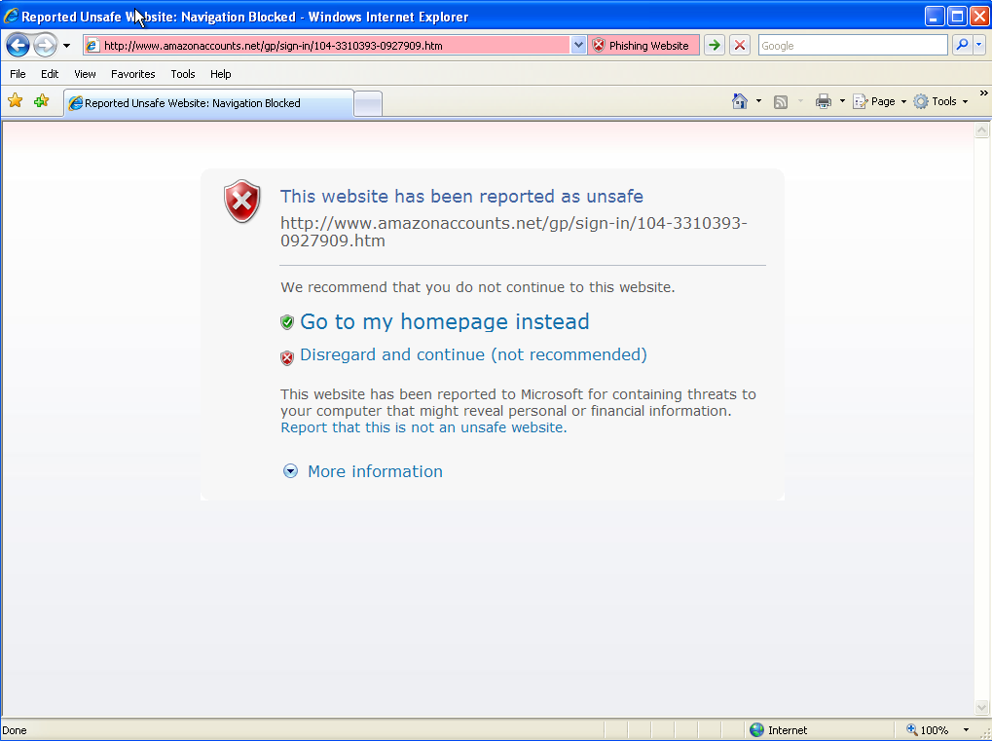
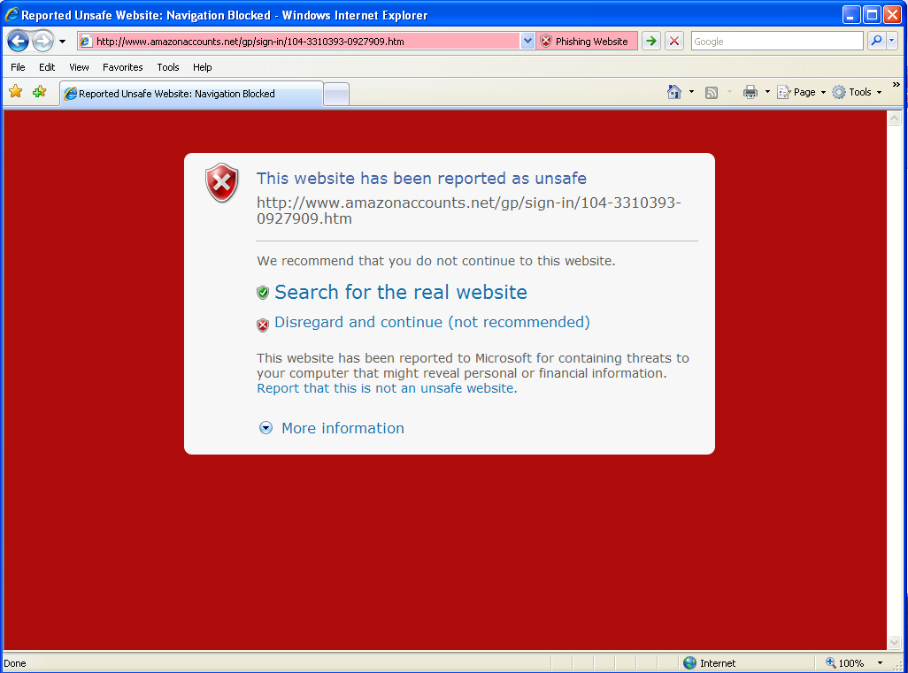

Slide 9
Method
Recruited Hotmail users to visit Microsoft for a usability study of Hotmail
We paid them to read/interact with email
…deletion counted as an interaction
We sent a phishing message towards the end that attempted to steal their actual Hotmail credentials, triggering a warning

Slide 10
Results
Interaction between background and options
More time viewing the warning (Χ²=7.83, p<0.020)
Attributed to Control vs. Search (p<0.010, d=0.98)
Recognition (Φ=0.497, p<0.001)
Control: 53%
Home: 33%
Search: 20%
So why were they still phished?
Condition | Phished | Total Time
Control | 5 | 12.0s
Home | 3 | 17.8s
Search | 4 | 31.0s

Slide 11
It all comes down to risk
Only 24% understood the consequences
Everyone else mentioned generic threats
Malware, spam, spyware, etc.
“this is not my computer”
“I was not using my personal computer so I didn't care if this one got infected”
Misunderstanding of threat model
10 of 12 phished said website looked legit
Two weren’t sure, but submitted info anyway

Slide 12
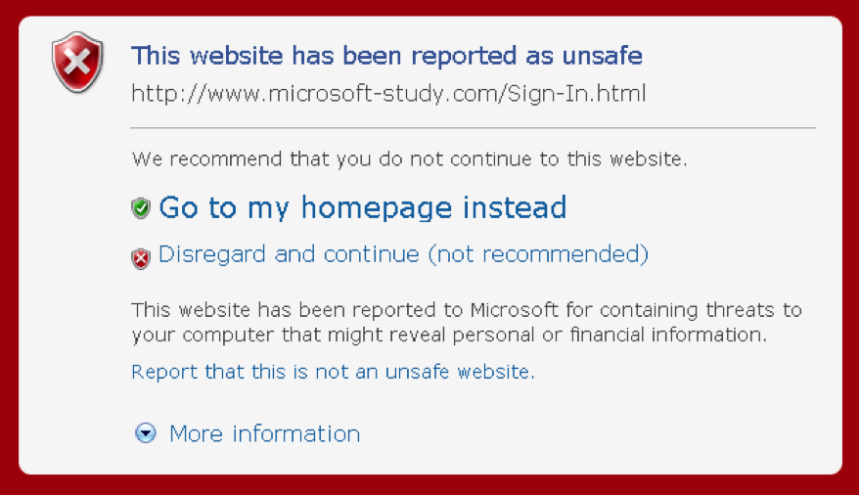

Slide 13
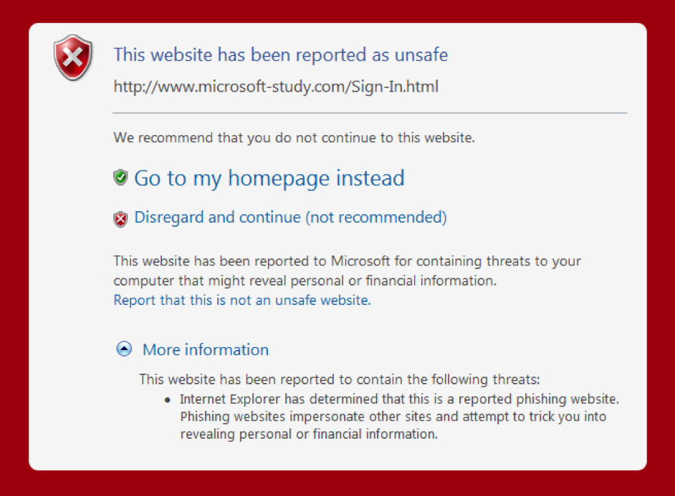

Slide 14
Bounded rationality
What did you believe the warning suggested?
11 of 12 “victims” said to “leave the website”
10 of 12 said website “looked legitimate”
9 of 10 who clicked more information were not victims

Slide 15
Moral hazard
Only 14 (31% of 45) understood that the threat was to their personal information…
…everyone else mentioned threats to computer:
“I could potentially get a virus or spyware”
“Getting a virus running on your computer”
“Will get some spyware”
Rational behavior, if these threats were correct!

Slide 16
Conclusion
The warnings failed to motivate participants!
Bounded rationality
Moral hazard
Lesson: risks/consequences need to be explicitly stated to motivate users.

Slide 17
Epilogue
Crying Wolf: An Empirical Study of SSL Warning Effectiveness
USENIX Security ’09, with J. Sunshine, H. Almuhimedi, N. Atri, and L. F. Cranor
Controlled experiment to validate these observations: concisely stating risks improved SSL warning effectiveness

Slide 18
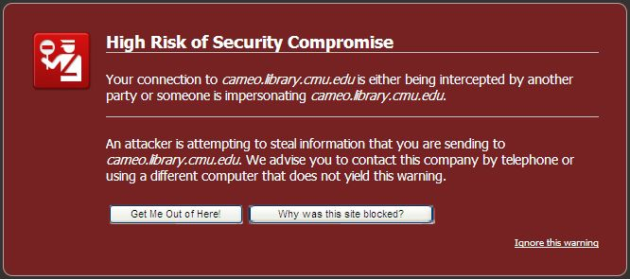
Epilogue
Users ignored the warning on sites that were not collecting sensitive information, but obeyed it on sites that were!

Slide 19
Questions?

